Slide 1

SWE 4010
ARTIFICIAL INTELLIGENCE
21 MIS 1070 – MINNA FATHIMA

Slide 2
IDENTIFYING AIRLINE PASSENGER SATISFACTION
USING MACHINE LEARNING
REVIEW 3

Slide 3
ABSTRACT
This project aims to utilize machine learning techniques to identify and analyze factors affecting airline passenger satisfaction. By analyzing a dataset containing passenger reviews and flight details, the project seeks to develop a predictive model that can accurately assess passenger satisfaction levels. The insights gained from this analysis can help airlines improve their services and enhance customer experiences.
Additionally, datasets containing customer satisfaction surveys are analyzed through exploratory data analysis, and predictive models are developed to forecast passenger satisfaction levels. Studies investigate passenger satisfaction comprehensively, providing insights for airlines to formulate strategies and improve service quality based on data mining techniques.
Machine learning techniques, including Logistic regression, Decision tree, Random forest, KNN have been experimented with to predict and solve airline passenger satisfaction issues, demonstrating the versatility of supervised learning in this domain. Classification algorithms have also been employed to predict airline passenger satisfaction, further contributing to the understanding and enhancement of customer experiences within the aviation industry.

Slide 4
PROBLEM STATEMENT
Airline passenger satisfaction is a critical aspect of the aviation industry. However, identifying the key factors that influence passenger satisfaction can be challenging due to the diverse nature of passenger preferences and the large volume of feedback data generated.
Traditional methods of analyzing passenger feedback are often time- consuming and lack the ability to provide real-time insights, highlighting the need for a more efficient and data-driven approach.
Additionally, there is a need to develop a scalable solution that can adapt to changing passenger preferences and industry trends, ultimately aiming to improve overall customer satisfaction and loyalty.

Slide 5
PROBLEM DESCRIPTION
The project will focus on analyzing a dataset containing information such as flight details (e.g., airline, flight duration, departure/arrival times), passenger demographics (e.g., age, gender, travel frequency), and passenger reviews (e.g., ratings, seat comfort, check-in service, inflight service, flight delays, cleanliness, satisfaction,etc). The challenge is to extract meaningful insights from this data to understand the factors that contribute to passenger satisfaction and develop a predictive model that can accurately predict passenger satisfaction levels based on these factors.

Slide 6
LITERATURE SURVEY

Slide 7
1. The adverse impact of flight delays on passenger satisfaction: An innovative prediction model utilizing wide & deep learning
Cen Song, Xiaoqian Ma, Catherine Ardizzone, Jun Zhuang
This article investigates the impact of flight delays on passenger satisfaction, presenting a predictive model using a Kaggle dataset. Through Pearson correlation and PCA-K- means, it explores in-flight services and passenger traits. The novel satisfaction prediction model, based on Wide & Deep algorithm, outperforms MLP, SVM, and Random Forest, as indicated by feature importance analysis using DeepLIFT. The study enhances understanding of factors affecting satisfaction post-flight delays, providing insights and recommendations for improved airline service quality.

Slide 8
2. Utilizing a machine learning ensemble to evaluate the service quality and passenger satisfaction among public transportations
Ardvin Kester S. Ong, E.T. Yuchengo, Duke Elijah R. Juan, Prince Miro R. Motilla
This research addresses the scarcity of studies on passenger satisfaction in Philippine public utility vehicles (PUVs). Using an online survey with 600 respondents, the study employs Machine Learning Algorithms (MLA) like Deep Learning Neural Network, Decision Tree, and Random Forest Classifier. Findings emphasize the importance of route efficiency, safety, value for money, and meeting passenger expectations in influencing satisfaction and future intentions. The study provides a theoretical foundation for addressing traffic issues and shaping PUVs and policies. Future research can delve deeper into specific service quality factors and PUV types, leveraging MLA for more efficient analysis.

Slide 9
3. Predicting passengers’ feedback rate for airport
service quality
Mohammed Saad M. Alanazi, Karl Jenkins, Jun Li
This study addresses the underexplored domain of airport service quality evaluation on Google Maps compared to Twitter. Utilizing Long-Short Term Memory and Convolution Neural Networks, the developed architecture considers review length, likes, and key words. Testing under various parameters, the polarity and rating prediction models consistently performed. Data collected from crowded Arabic Peninsula airports (Doha and Dubai) revealed an imbalance, with positive reviews outweighing negatives. The research contributes to sentiment analysis literature, emphasizing Google Maps' potential for valuable insights into airport service quality.

Slide 10
4. Forecast and analysis of aircraft passenger satisfaction based on RF RFE LR model
Xuchu Jiang, Ying Zhang, Ying Li, Biao Zhang
This paper addresses the challenges faced by the global civil aviation industry due to the 2020 coronavirus outbreak and proposes a RF RFE Logistic model for feature selection to predict aircraft passenger satisfaction. The study compares classification models and concludes that random forest, after RF RFE feature selection, demonstrates the best performance. The final model identifies 17 influential variables, offering insights for airlines to enhance services and navigate challenging situations. The findings underscore the importance of proactive measures for improving passenger satisfaction in the aviation sector.

Slide 11
5. Predicting Airline Passenger Satisfaction with Classification Algorithms
B. Herawan Hayadi, Jin-Mook Kim, Khodijah Hulliyah, Husni Teja Sukmana
The global aviation industry, severely impacted by Covid-19, faces financial losses and bankruptcies. Despite challenges, a post-pandemic surge in air travel demand is anticipated. This research focuses on analyzing key success factors and competition within the industry. Utilizing classification models, the Random Forest Algorithm achieves 99% accuracy, identifying Inflight Wi-Fi Service as a crucial factor for customer satisfaction. The study emphasizes the industry's resilience and the pivotal role of certain services in ensuring passenger contentment.

Slide 12
6. Marketing-Airplane Passenger Satisfaction Prediction Using Machine Learning Techniques
Bekee Sorbarisere Yirakpoa, Mercy Nwanyanwu
Customer satisfaction questionnaires provide valuable insights for companies aiming at loyalty and retention. This study, utilizing a real dataset from 'Falcon airlines,' compares regression models such as Logistic Regression, Decision Tree, Bagging classifier, and Random Forest. The experimental results highlight the effectiveness of ensemble models, with Random Forest outperforming others in terms of Recall and Precision. The findings underscore the significance of ensemble approaches for predicting customer satisfaction in diverse scenarios.

Slide 13
METHODOLOGY
Data Collection: Gather a dataset containing passenger reviews, flight details, and
demographics from various sources.
Data Preprocessing: Clean the data by removing duplicates, irrelevant information, and handling missing values. Preprocess text data by removing stopwords and performing tokenization and lemmatization.
Feature Extraction: Extract relevant features from the dataset, including flight details, passenger demographics, and sentiment features from reviews, using techniques like TF-IDF or word embeddings.
Model Selection: Choose suitable machine learning models (e.g., Random Forest, Logistic Regression, Gradient Boosting) for predicting passenger satisfaction levels. Consider using ensemble methods for improved performance.
Model Training and Evaluation: Split the dataset into training and testing sets. Train the selected models on the training set and evaluate their performance using metrics like accuracy, precision, recall, and F1-score. Perform hyperparameter tuning to optimize model performance.

Slide 14
Feature Importance Analysis: Analyze the feature importance from the trained models to understand the factors impacting passenger satisfaction using techniques like SHAP values or permutation importance.
Model Deployment: Deploy the trained model to a production environment for real-time prediction of passenger satisfaction levels. Use cloud services or containerization for efficient deployment.
Continuous Monitoring and Improvement: Monitor the deployed model's performance regularly and gather feedback for improvement. Update the model using new data and retrain it periodically.
Documentation and Reporting: Document the entire process, including data preprocessing steps, model selection criteria, and evaluation metrics. Prepare a report summarizing findings, insights, and recommendations based on the model's predictions.
Ethical Considerations: Ensure compliance with ethical guidelines regarding data privacy and use of passenger feedback. Protect sensitive information and anonymize data where necessary.

Slide 15
IMPLEMENTATION

Slide 16
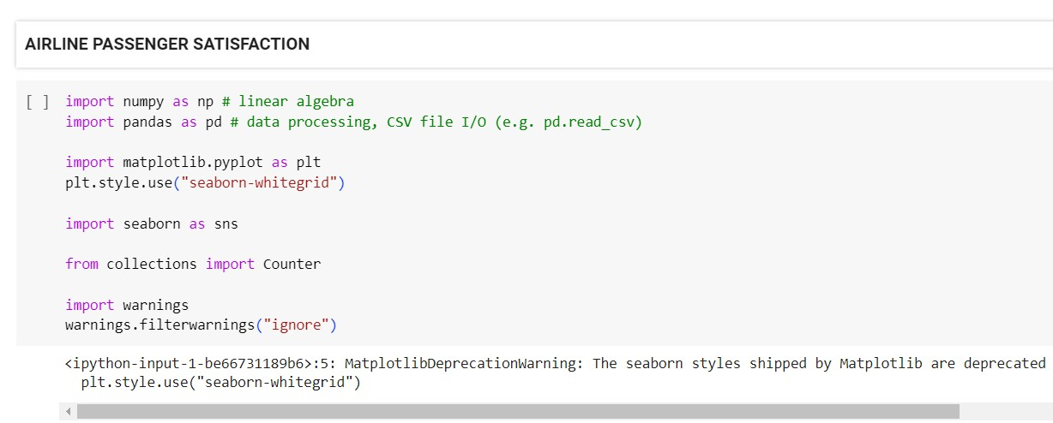
IMPORT AND INSTALL DEPENDENCIES

Slide 17
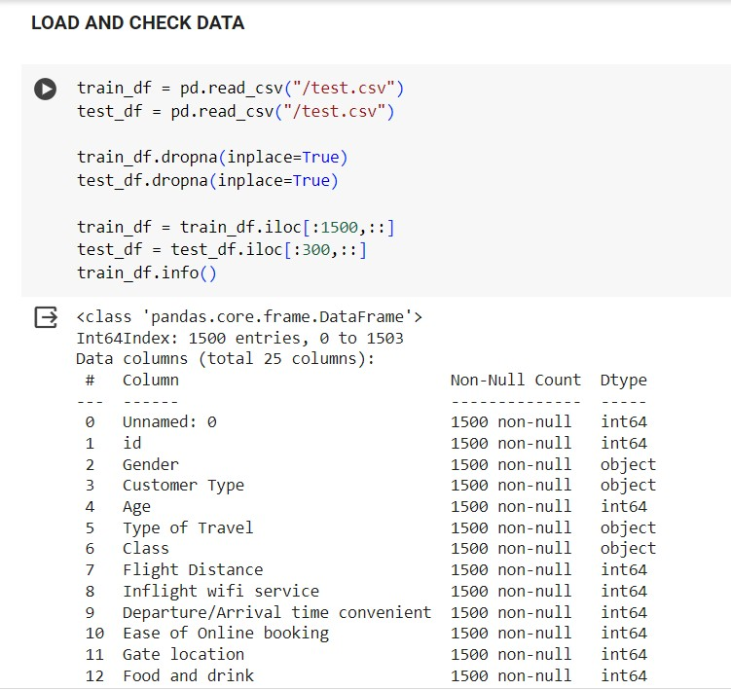
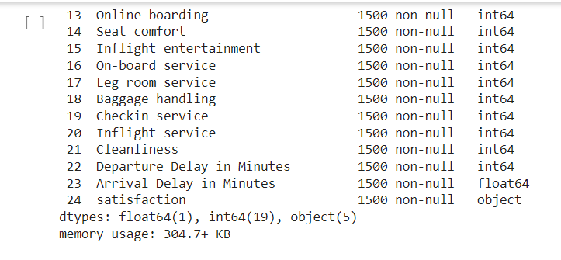
LOADING AND CHECKING DATA

Slide 18
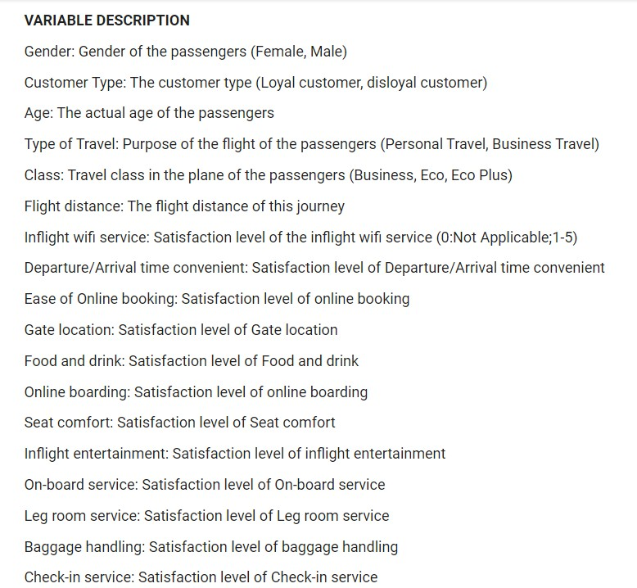
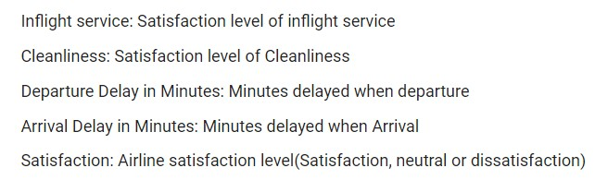
VARIABLE DESCRIPTION

Slide 19
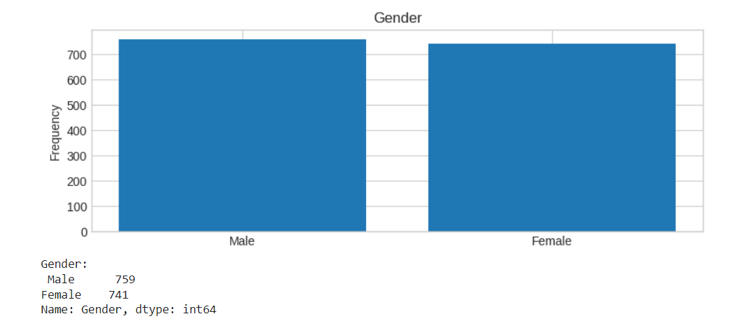
SIMPLE VISUALIZATION PLOTS

Slide 20
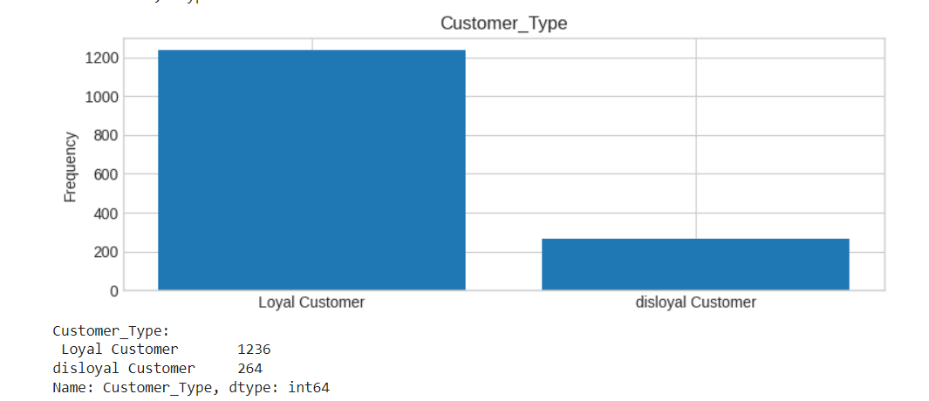
CUSTOMER TYPE V/S FREQUENCY

Slide 21
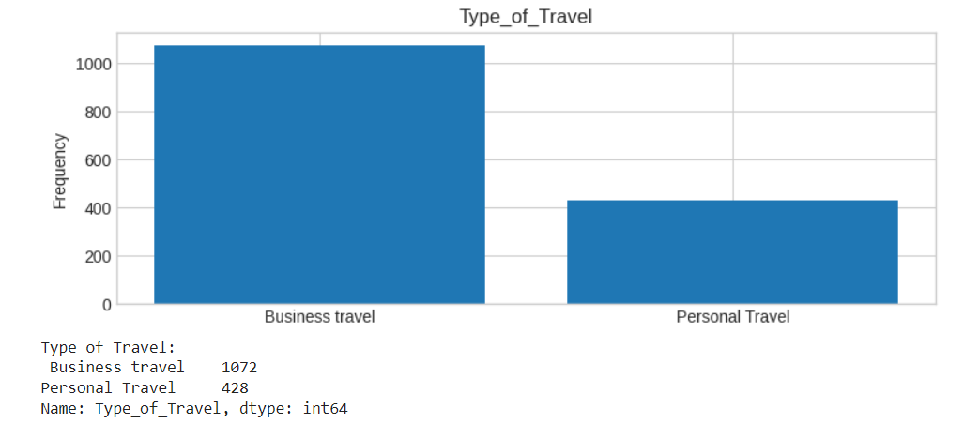
TYPE OF TRAVEL V/S FREQUENCY

Slide 22
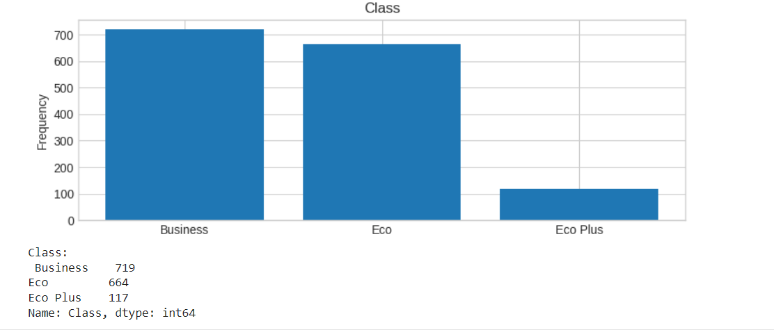
CLASS V/S FREQUENCY

Slide 23
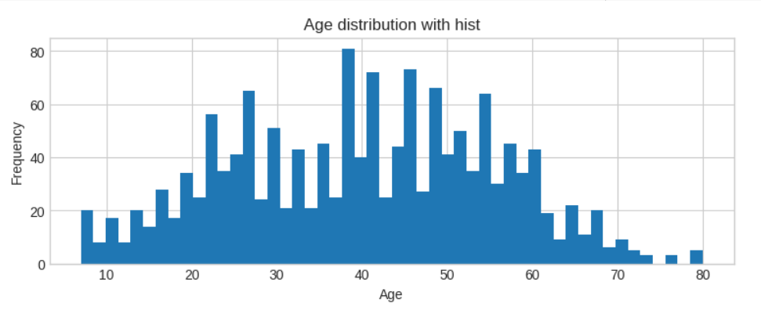
AGE DISTRIBUTION V/S FREQUENCY

Slide 24
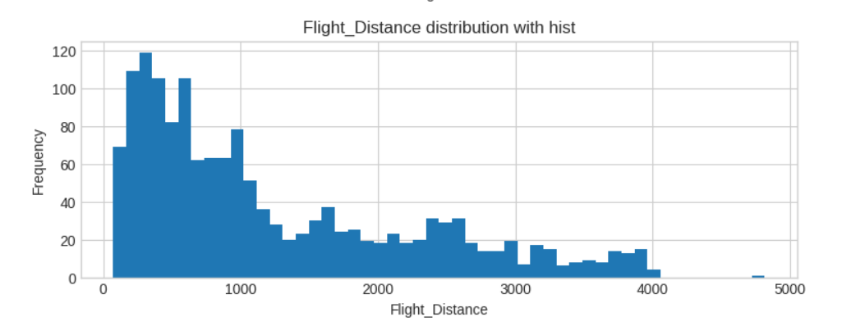
FLIGHT DISTANCE V/S FREQUENCY

Slide 25
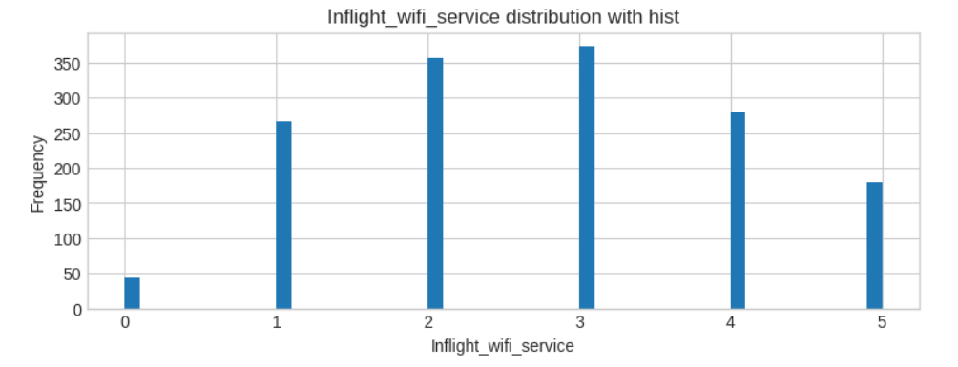
INFLIGHT WIFI SERVICE V/S FREQUENCY

Slide 26
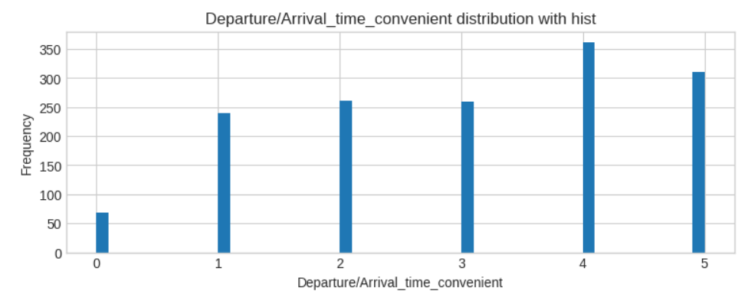
DEPARTURE / ARRIVAL TIME CONVENIENT V/S FREQUENCY

Slide 27
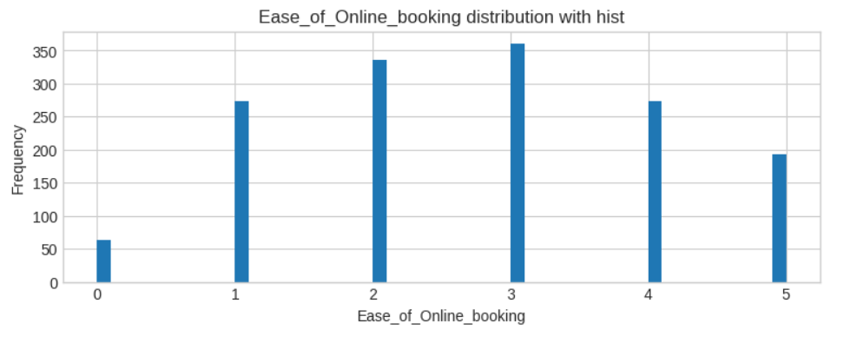
EASE OF ONLINE BOOKING V/S FREQUENCY

Slide 28
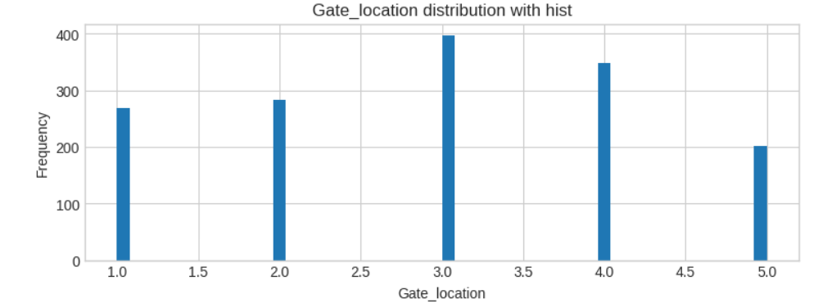
GATE LOCATION V/S FREQUENCY

Slide 29
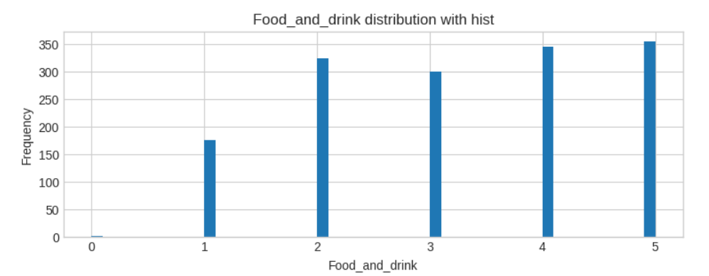
V/S FREQUENCY
FOOD AND DRINK

Slide 30
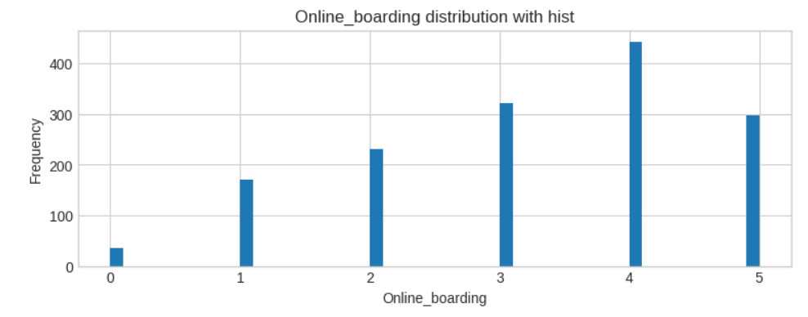
ONLINE BOARDING V/S FREQUENCY

Slide 31
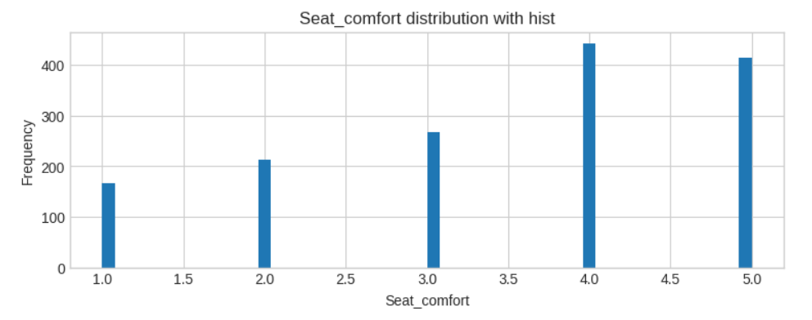
SEAT COMFORT V/S FREQUENCY

Slide 32
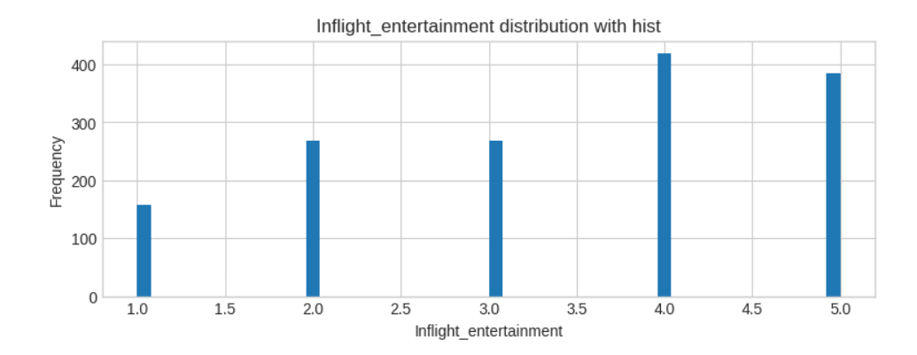
INFLIGHT ENTERTAINMENT V/S FREQUENCY

Slide 33
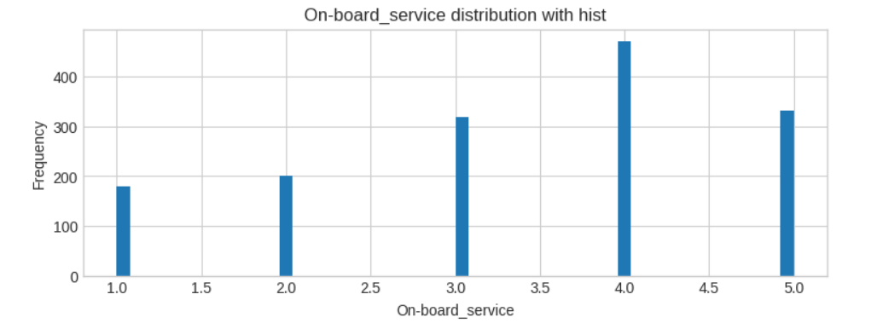
ON-BOARD SERVICE V/S FREQUENCY

Slide 34
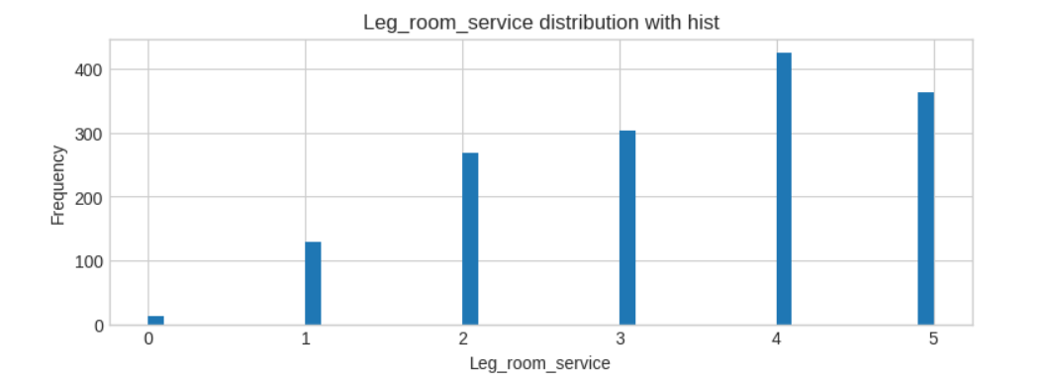
LEG ROOM SERVICE V/S FREQUENCY

Slide 35
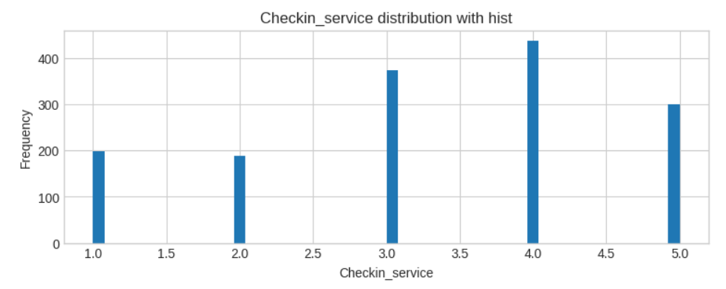
CHECKIN SERVICE V/S FREQUENCY

Slide 36
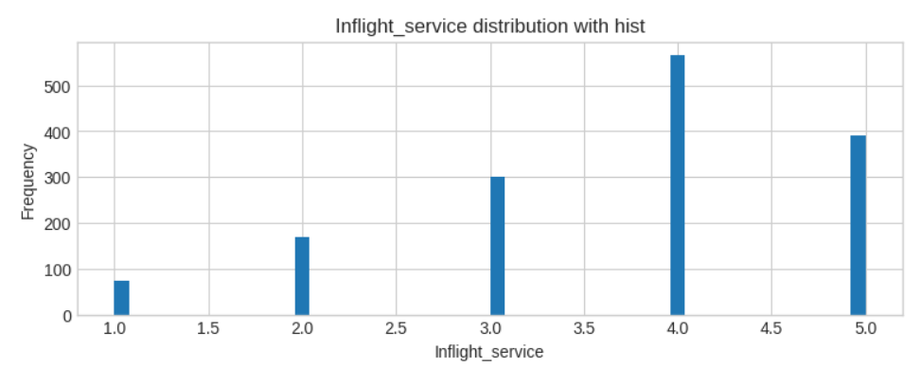
INFLIGHT SERVICE V/S FREQUENCY

Slide 37
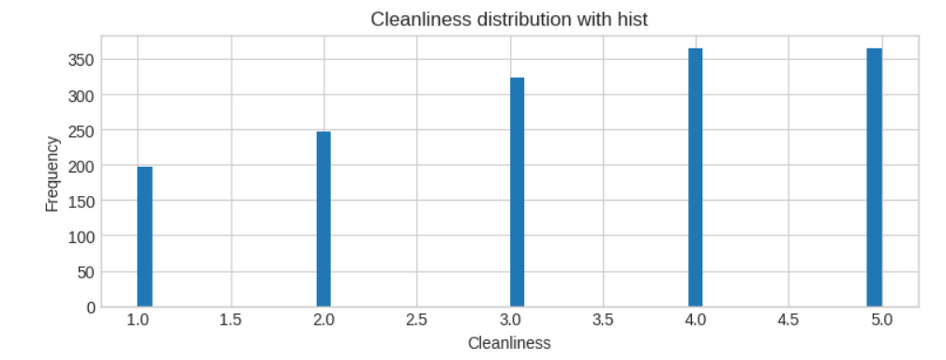
CLEANLINESS V/S FREQUENCY

Slide 38
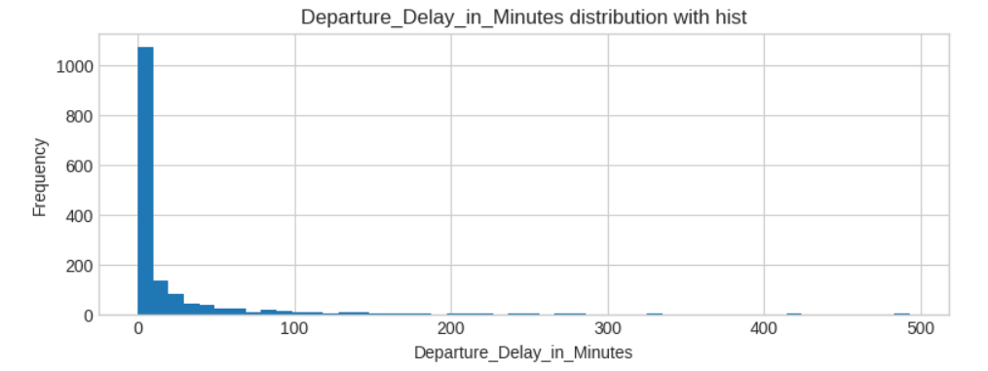
DEPARTURE DELAY V/S FREQUENCY

Slide 39
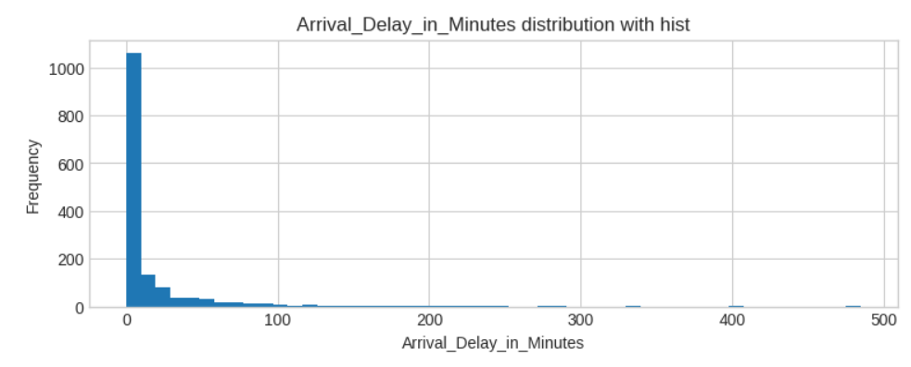
ARRIVAL DELAY V/S FREQUENCY

Slide 40
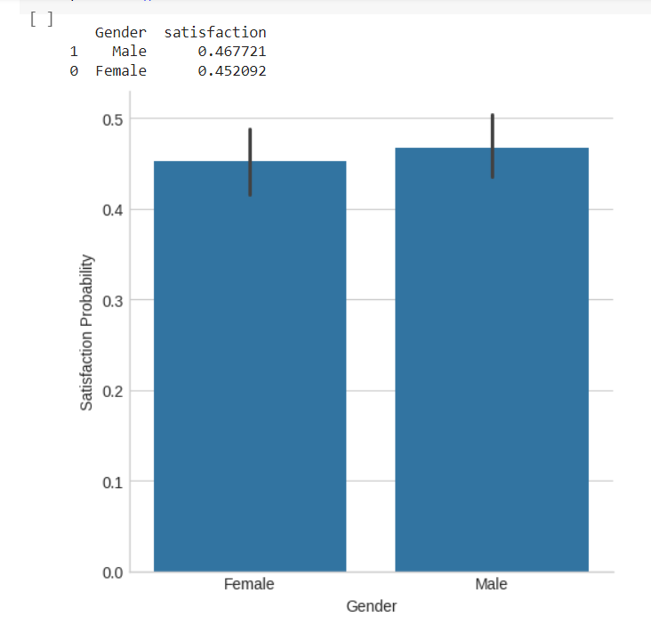
GENDER V/S SATISFACTION PROBABILITY

Slide 41
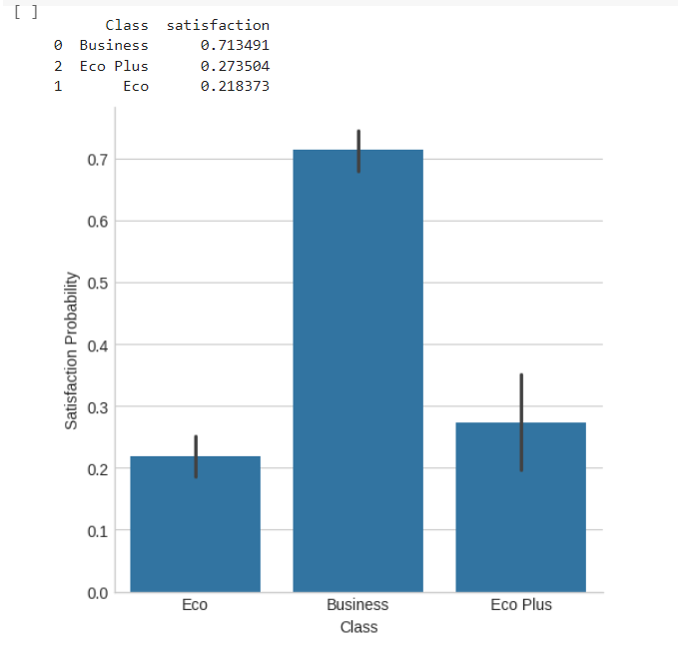
CLASS V/S SATISFACTION PROBABILITY

Slide 42
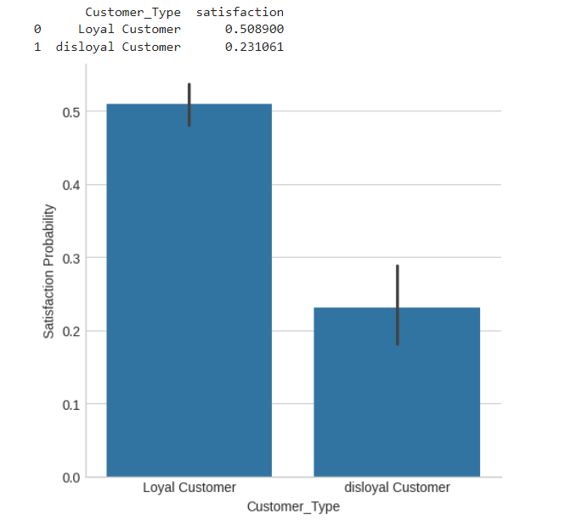
CUSTOMER TYPE V/S SATISFACTION PROBABILITY

Slide 43
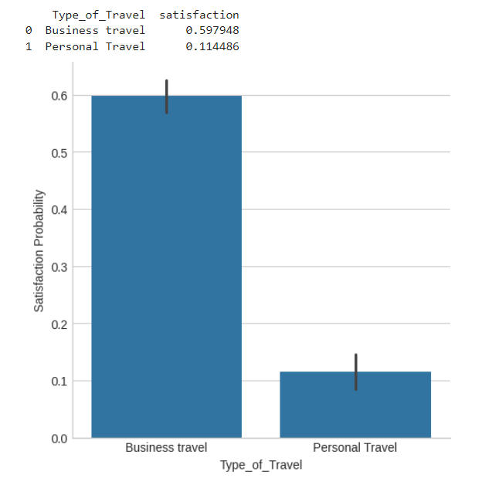
TYPE OF TRAVEL V/S SATISFACTION PROBABILITY

Slide 44
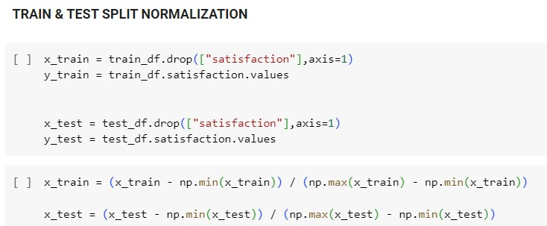
TRAIN & TEST SPLIT NORMALIZATION

Slide 45
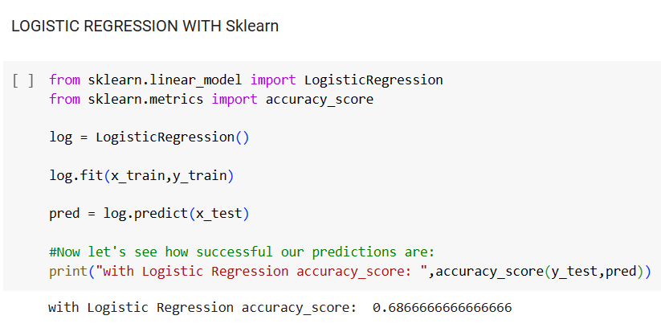
PREDICTING ACCURACIES OF MACHINE LEARNING ALGORITHMS

Slide 46
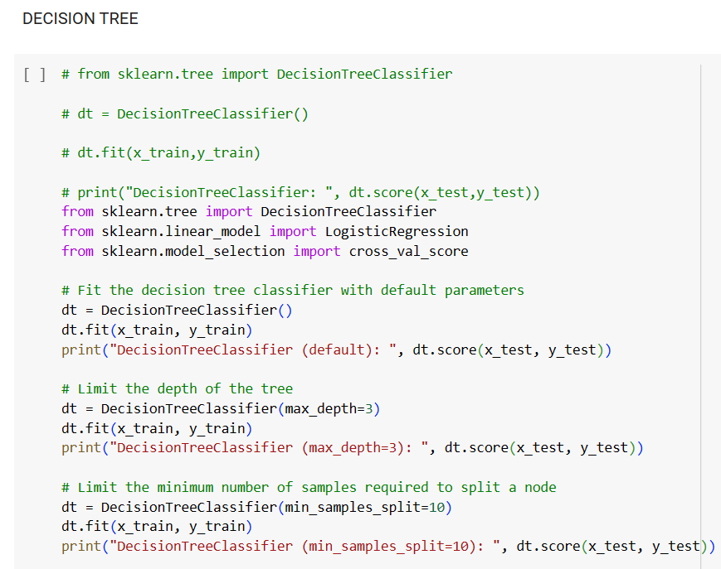
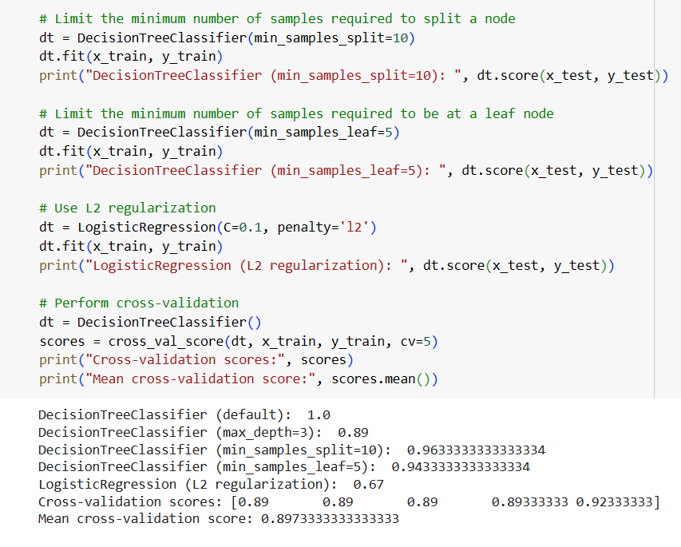

Slide 47
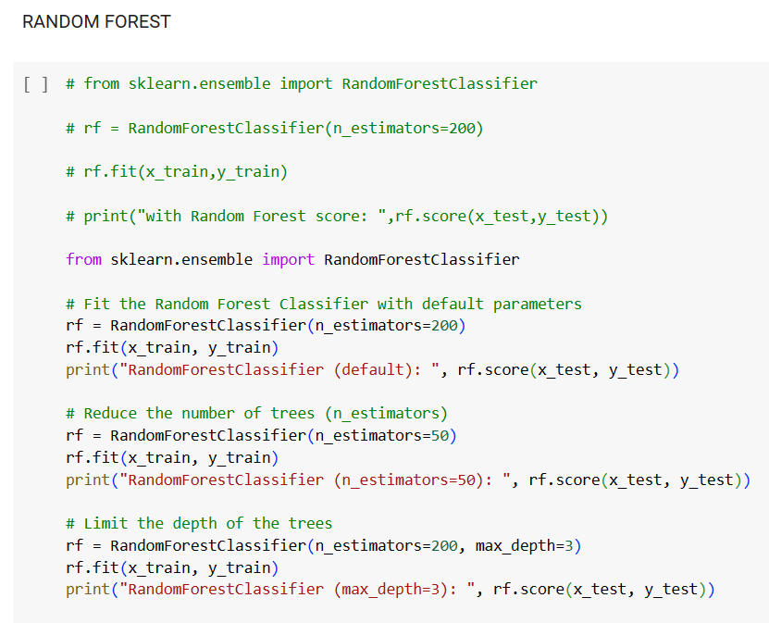
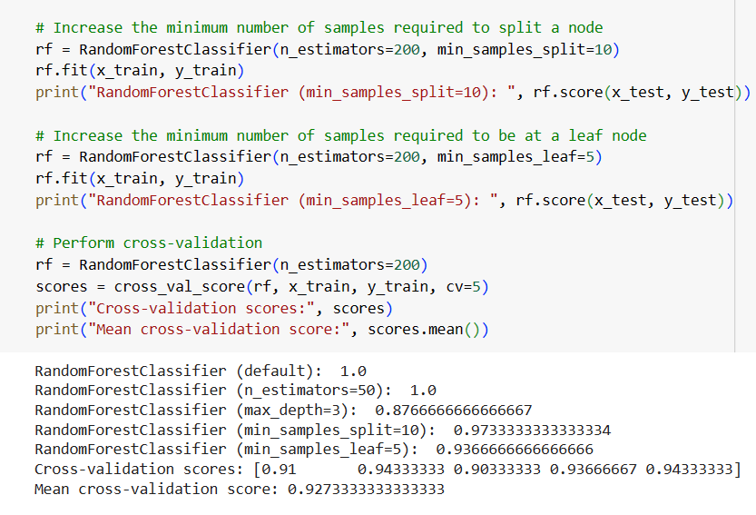

Slide 48
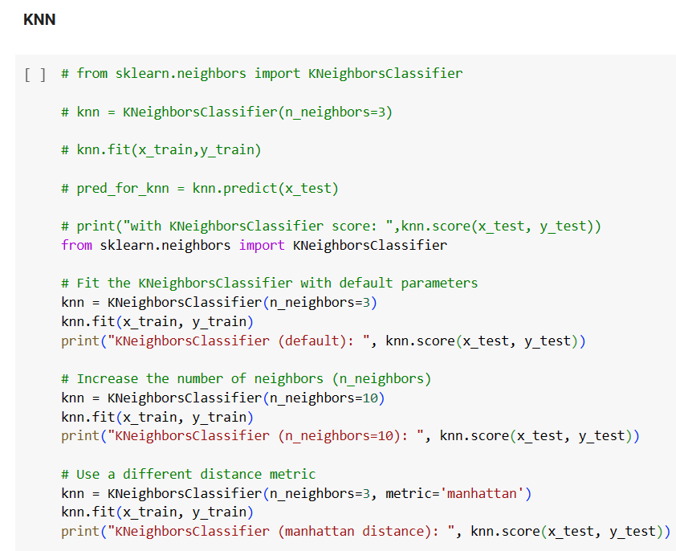
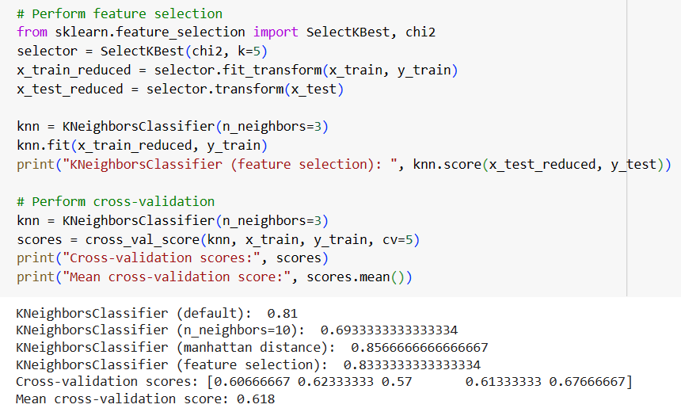

Slide 49
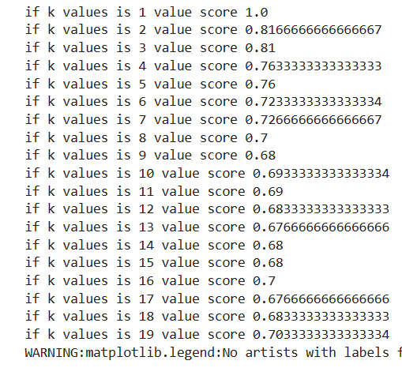
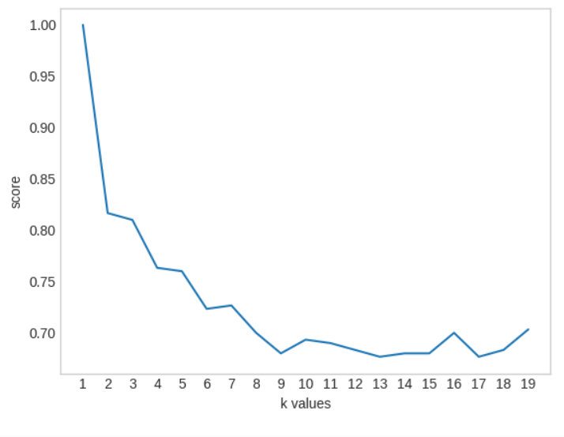

Slide 50
RESULT
Logistic Regression – 0.6866666
Decision Tree – 0.89733333
Random Forest – 0.92733333
KNN – 0.618

Slide 51
REFERENCES
https://www.geeksforgeeks.org/k-nearest-neighbours/
https://www.ibm.com/topics/random- forest#:~:text=Random%20forest%20is%20a%20commonly,both%2 0classification%20and%20regression%20problems.
https://www.kaggle.com/datasets
https://www.ibm.com/topics/logistic-regression

Slide 52
THANK YOU !!!

